Slide 1

Asynchronous Programming and Promises
Promises. Async / Await.
SoftUni Team
Technical Trainers
Software University
http://softuni.bg

Slide 2
Table of Contents
Asynchronous Programming
Promises
Async / Await

Slide 3
Have a Question?
sli.do #JS-CORE

Slide 4

Asynchronous Programming
Synchronous vs Asynchronous

Slide 5
Asynchronous Programming
Not the same thing as concurrent or multi-threaded
There can be asynchronous code, but it is generally single-threaded
Needs to be structured using callback functions
In current versions of JS there are also:
Promises
Async / Await pattern

Slide 6
Asynchronous Programming
Runs several tasks (pieces of code) in parallel, at the same time
Synchronous
Asynchronous
Number of tasks
Number of tasks
1
1
20 seconds
20 seconds
2
2
7 seconds
7 seconds
3
3
10 seconds
10 seconds
4
4
8 seconds
8 seconds

Slide 7
Asynchronous Programming - Example
The following commands will be executed as follows:
console.log("Hello.");
// Hello.
setTimeout(function() {
console.log("Goodbye!");
}, 2000);
// Hello again!
// Goodbye!
console.log("Hello again!");

Slide 8

Promises
Objects Holding Asynchronous Operations

Slide 9
What is a Promise?
An object holding an asynchronous operation
States:
Pending - operation still running (unfinished)
Fulfilled - operation finished (the result is available)
Failed - operation failed (an error is available)
Promises use the Promise object
new Promise(executor);

Slide 10
What is a Promise?
returns
returns
…
Promise
Promise
then
then
resolve
onFulfilled
return data
resolve
onFulfilled
reject
onRejected
throw error
reject
onRejected

Slide 11
Promise Methods
Promise.reject(reason)
Returns an object that is rejected with the given reason
Promise.resolve(value)
Returns an object that is resolved with the given value
Promise.all(iterable)
Returns a promise that either fulfills when all of the promises have fulfilled or rejects as soon as one of them rejects

Slide 12
Promise.then() - Example
console.log('Before promise');
new Promise(function(resolve, reject) {
setTimeout(function() {
resolve('done');
}, 500);
})
.then(function(res) {
console.log('Then returned: ' + res);
});
// Before promise
Resolved after 500 ms
// After promise
// Then returned: done
console.log('After promise');

Slide 13
Promise.catch() - Example
console.log('Before promise');
new Promise(function(resolve, reject) {
setTimeout(function() {
reject('fail');
}, 500);
})
.then(function(result) { console.log(result); });
.catch(function(error) { console.log(error); });
// Before promise
// After promise
Rejected after 500 ms
// fail
console.log('After promise');

Slide 14
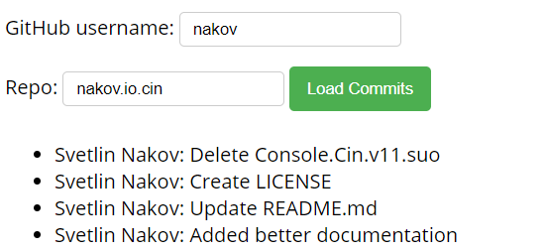
Problem: Load GitHub Commits
GitHub username:
<input type="text" id="username" value="nakov" /> <br>
Repo: <input type="text" id="repo" value="nakov.io.cin" />
<button onclick="loadCommits()">Load Commits</button>
<ul id="commits"></ul>
<script>
function loadCommits() {
// Use Fetch API
}
</script>

Slide 15

Async / Await
Simplified Promises

Slide 16
Async Functions
Operate asynchronously via the event loop
Contain an await expression that:
Is only valid inside async functions
Pauses the execution
Waits for the Promise's resolution
Async / Await is similar to combining generators and promises

Slide 17
Async Functions (2)
function resolveAfter2Seconds() {
return new Promise(resolve => {
setTimeout(() => {
resolve('resolved');
}, 2000);
});
}
Expected output:
// calling
// resolved
async function asyncCall() {
console.log('calling');
var result = await resolveAfter2Seconds();
console.log(result);
}

Slide 18
Async Functions (3)
Do not confuse await with Promise.then()
To await two or more promises in parallel, use Promise.then()
If a promise resolves normally, then await promise returns the result
In case of a rejection, it throws an error
async function f() { try {
let response = await fetch();
let user = await response.json();
} catch (err) {
// catches errors both in fetch and
response.json
alert(err);
}
}
async function f() {
let response = await fetch();
}
// f() becomes a rejected promise
f().catch(alert);

Slide 19
Sequential Execution
To execute different promise methods one by one, use Async /Await
function doJob(x,sec) {
return new Promise(resolve => {
console.log('Start: ' + x);
setTimeout(() => {
console.log('End: ' + x);
resolve(x);
}, sec *1000);
});
}
async function SerialFlow() {
let result1 = await doJob(1,1);
let result2 = await doJob(2,2);
let result3 = await doJob(3,3);
let finalResult = result1 + result2 + result3;
console.log(finalResult);
}
// Start: 1
// End: 1
// Start: 2
// End: 2
// Start: 3
// End: 3
// 6

Slide 20
Concurrent Execution
async function ParallelFlow() {
let result1 = doJob(1,1);
let result2 = doJob(2,2);
let result3 = doJob(3,3);
let finalResult = await result1 + await result2 +
await result3;
console.log(finalResult);
}
// Expected output:
// Start: 1
// Start: 2
// Start: 3
// End: 1
// End: 2
// End: 3
// 6

Slide 21
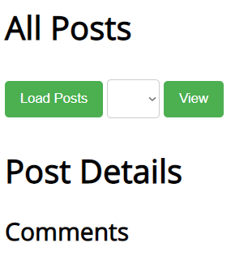
Problem: Blog
Write a program for reading blog content
It needs to make requests to the server
Display all blog posts and their comments
<h1>All Posts</h1>
<button id="btnLoadPosts">Load Posts</button>
<select id="posts"></select>
<button id="btnViewPost">View</button>
<h1 id="post-title">Post Details</h1>
<ul id="post-body"></ul>
<h2>Comments</h2>
<ul id="post-comments"></ul>
<script src="app.js"></script>

Slide 22
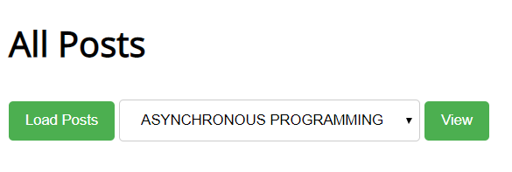
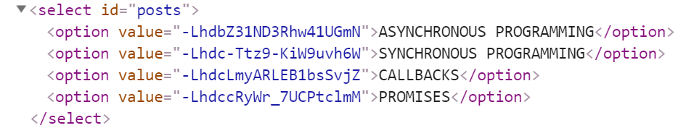
Problem: Blog - Example

Slide 23
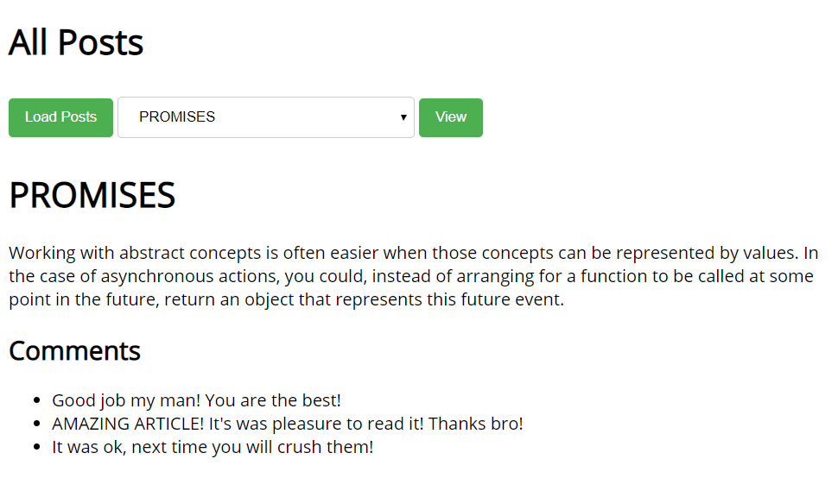
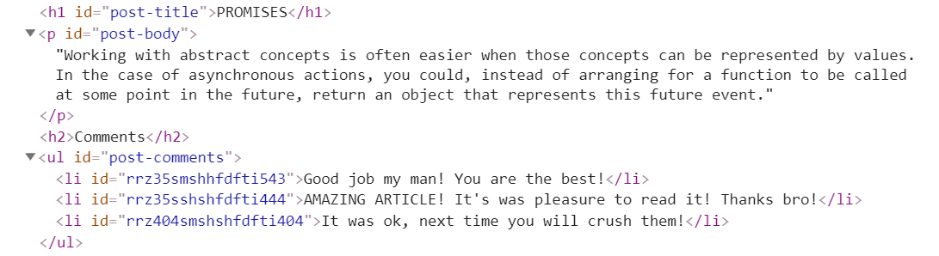
Problem: Blog - Example

Slide 24
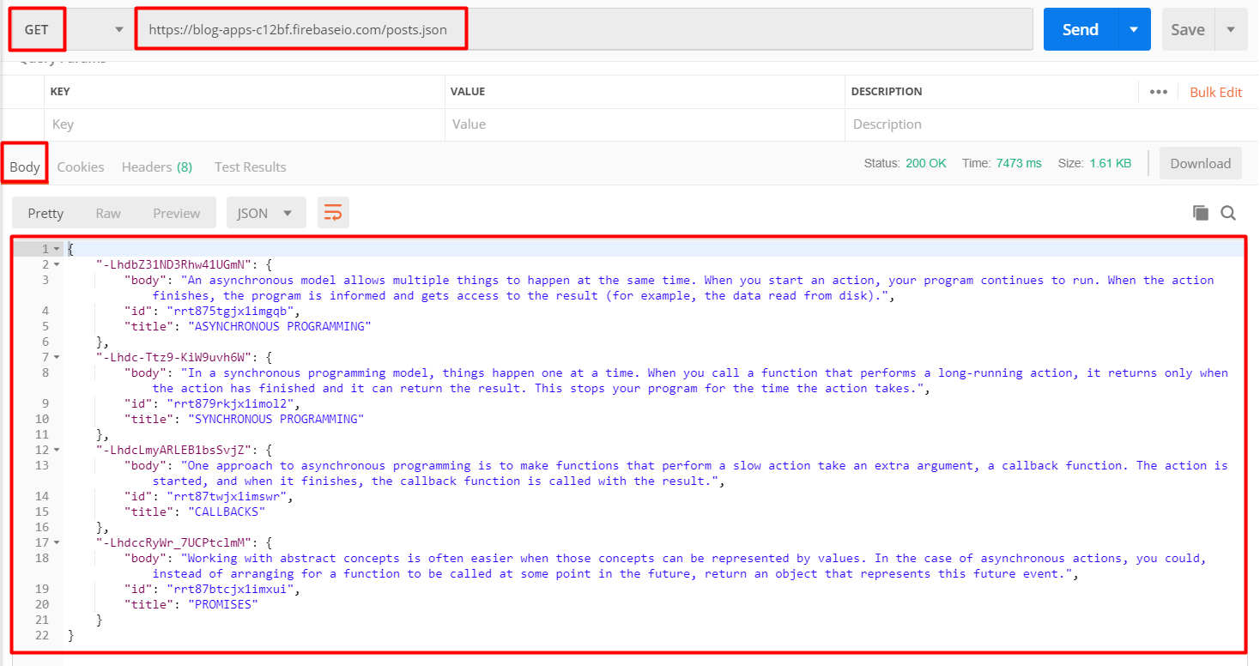
Problem: Blog - Get All Posts
https://blog-apps-c12bf.firebaseio.com/posts.json

Slide 25
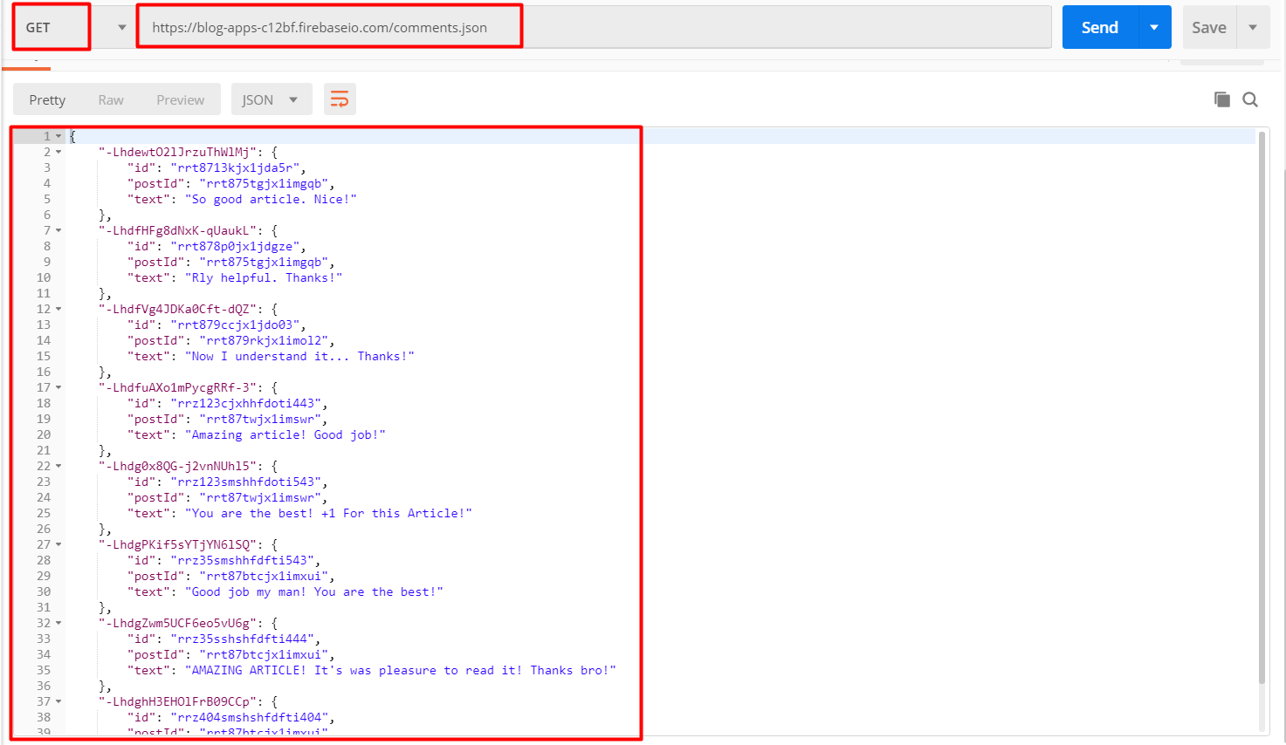
Problem: Blog - Get All Comments

Slide 26

Live Exercises

Slide 27

Summary
…
…
…
Asynchronous programming
Runs several tasks in parallel, at the same time
Promises hold operations
Can be resolved or rejected
Async functions contain an await expression. It:
Pauses the execution
Waits for the Promise's resolution

Slide 28
https://softuni.bg/courses/js-applications

Slide 29












SoftUni Diamond Partners

Slide 30




SoftUni Organizational Partners

Slide 31




Trainings @ Software University (SoftUni)
Software University – High-Quality Education and Employment Opportunities
softuni.bg
Software University Foundation
http://softuni.foundation/
Software University @ Facebook
facebook.com/SoftwareUniversity
Software University Forums
forum.softuni.bg

Slide 32

License
This course (slides, examples, demos, videos, homework, etc.) is licensed under the "Creative Commons Attribution-NonCommercial-ShareAlike 4.0 International" license

